Slide 2
Founded in 1999 by Norm Sr.
Class “A” license since 2001
Kitchens, Baths, Basements, Additions
Currently 15 employees and talented group of sub-contractors

Slide 3
Family

Slide 4
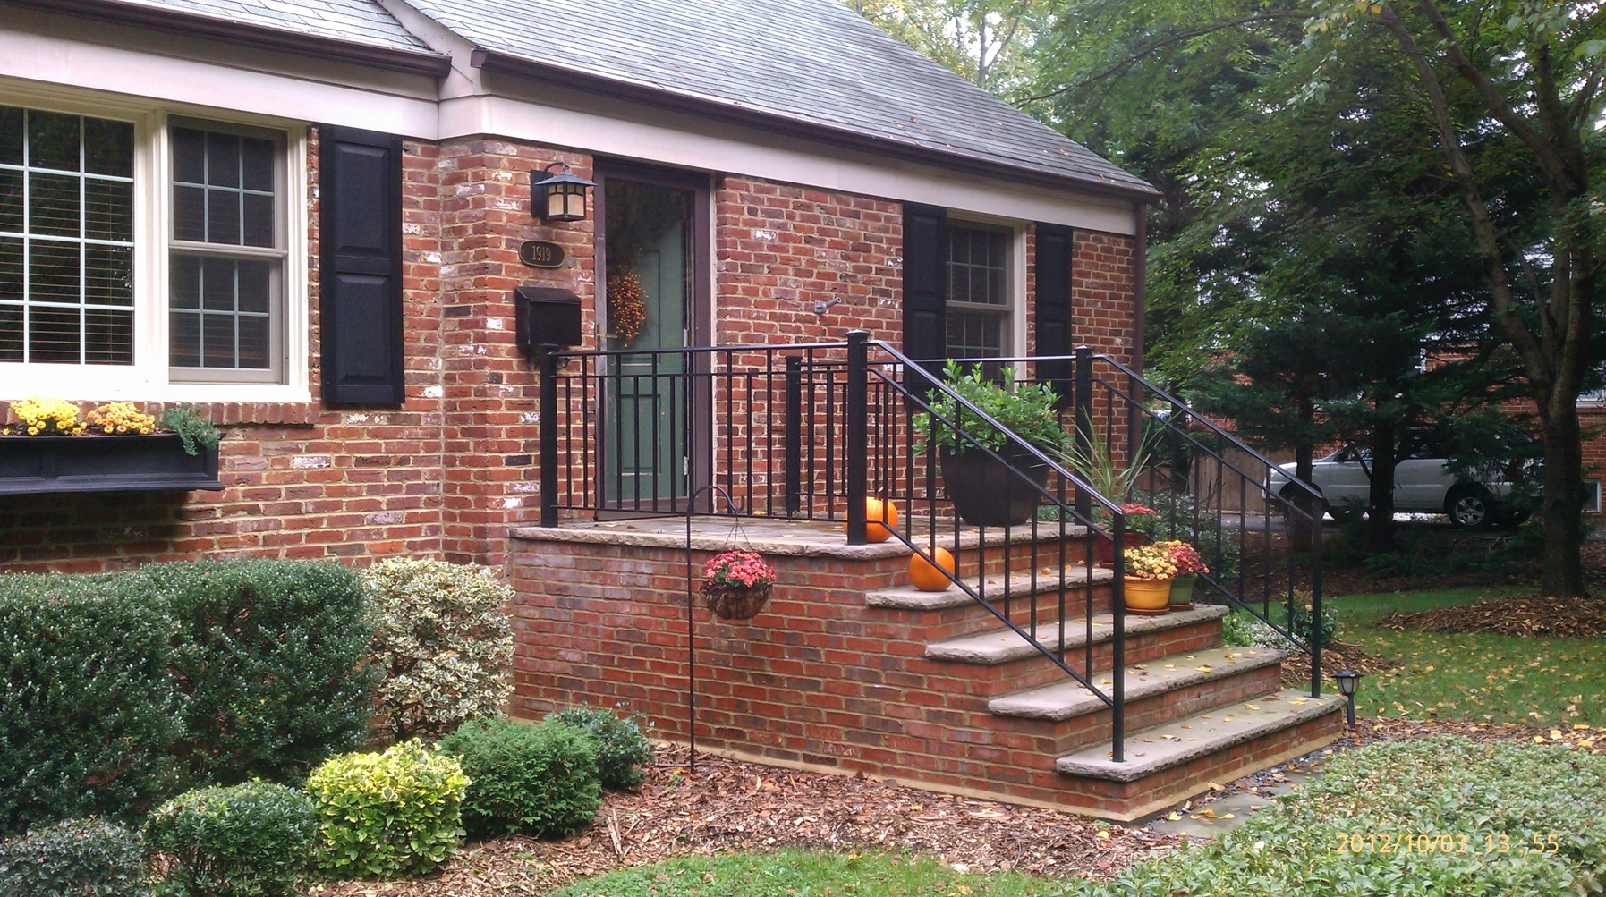
A traditional cape cod in Mclean that we completely renovated over 6 months

Slide 5
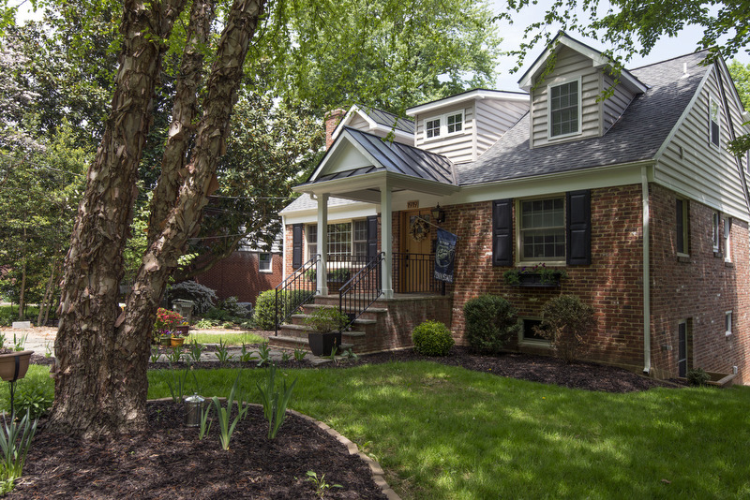
…the finished project which added about 800 sq feet to include new kitchen, master suite and 2 car garage

Slide 6
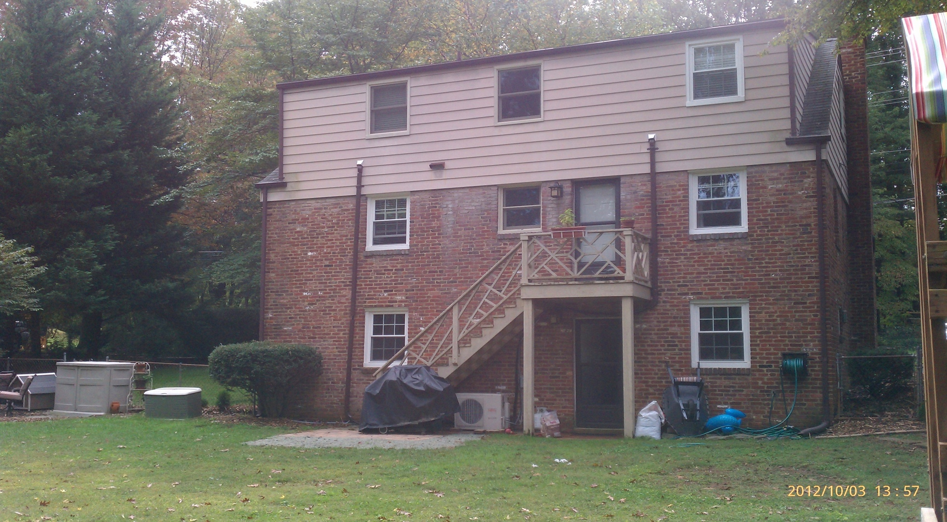
Back of the House Before Renovation

Slide 7
Foundation Complete…Framing the Garage

Slide 8
…Breaking Through to the House

Slide 9
The Kitchen and Second Level…

Slide 10
Working on the Front…

Slide 11
Working on the Interior (future kitchen)

Slide 12
Finishing the Exterior

Slide 13
New Hardwood Floors…

Slide 14
New Master Bath

Slide 15
New Larger, Open Family Room

Slide 16
New Open Kitchen

Slide 17
Other View

Slide 18
Dining Room, looking out the back

Slide 19
Master Bedroom

Slide 20
New Garage and Roof Top Deck

Slide 21
New Dormers, Portico, Windows & Door

