Slide 1
Utility of credit cards
For small business balance of payments and security of transaction

Slide 2
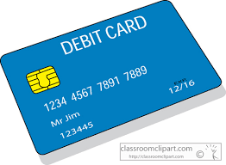
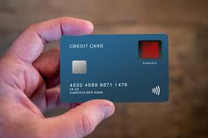
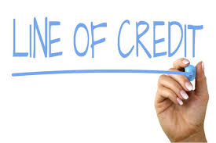
Debit card Credit card or LOC?

Slide 3
Debit card
Pros
Cons
No interest/ incredibly cheap for purchases.
Convenient for purchase at a merchant
Can be used for purchases online
Initial liability only $50.00
Directly connected to your business account.
Even cards with the zero liability offered by credit card companies usually still have caveats.
Have to inform issuer immediately(48 hrs)
After 48 hrs liability increases to $500.00
After 60 days liability unlimited
Have to wait until investigation is complete before receiving funds back

Slide 4
Credit Cardz
Pros
Cons
Grace Period(Bread and Butter) usually 30 days
Not directly attached to any bank account so limited exposure
Liability also capped at $50.00 and overall less liability
Can be used in the ways that debit card are used but with more versatility.
Points/ cash back
Some credit cards have annual fees
Interest after the grace period

Slide 5
Lines of credit
Pros
Cons
Access to cash that can help meet unforeseen or regular balance of payment issues
One underwriting process that gives you repeated access to cash
Interest is charged as soon as the line is drawn
Method of draw and payment.

Slide 6
The Prestige
Truth in Lending Act (Reg Z) and the Fair Credit Billing act You have 60 days from the date of Billing
Truth in lending is usually only for consumers but small business with personal guarantor are eligible due to a foot note.
Only covers fraudulent activity not accidental or unfortunate.
This fraud liability coverage built is not the only benefit but the most often overlooked by small business.

Slide 7
Q&A
You ask me questions
I answer them…maybe…if I can

