Slide 1
FTC Interiors
Window Treatments-Shades & More!
www.FTCInteriors.com
andrea@FTCInteriors.com
703-407-3770

Slide 2
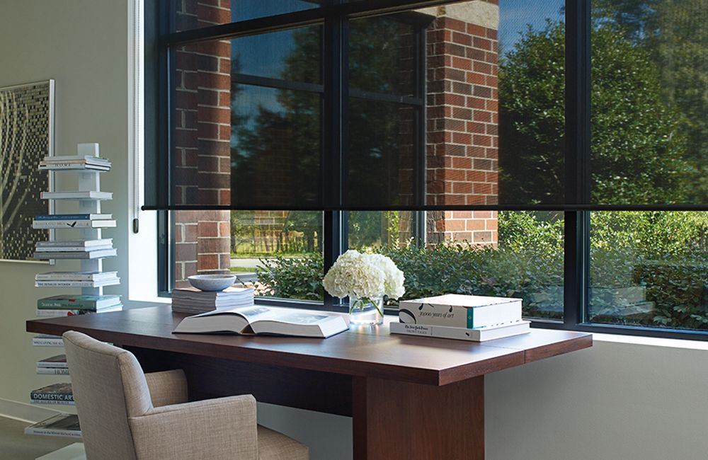
UV Ray Protection
Limit your exposure to UV rays. Protect art, furniture and family heirlooms from sun damage and unfortunate fading, all with the help of your window treatment.

Slide 3
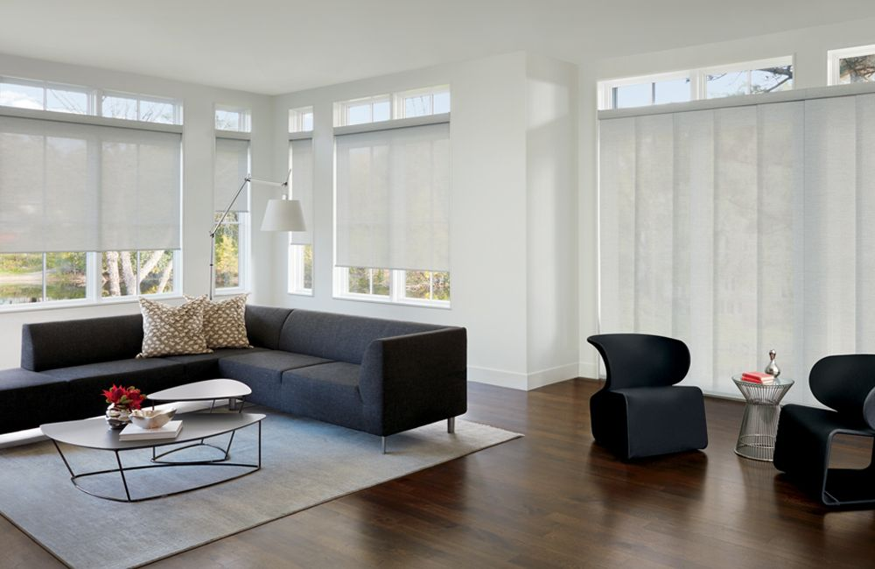
Indoor roller shades & panels
Our Designer Screen Shades come in a large selection of fabrics with varying opacities that allow you to select your preferred view and level of light. All of our Designer Screen Shades fabrics can be coordinated with our vertical Gliding Window Panels.

Slide 4
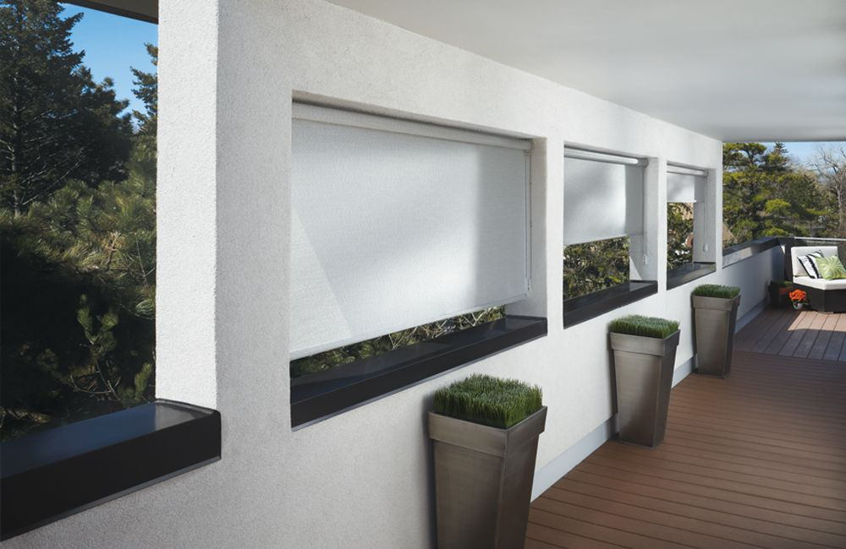
Outdoor patio shades
Protect your home from harmful sunlight with our Designer Screen Shades. These window treatments curb harsh sun rays and come in varying levels of opacity. Screen shades are lovely in all spaces, but particularly desirable for patios and sunrooms.

Slide 5
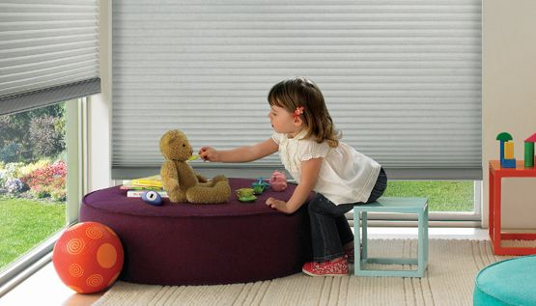
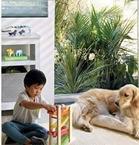
Child Safety is Serious Business
From cordless and motorized operating systems, retractable lift cords, cord tensioners and wand controls, we offer a wide array of operating system options for enhanced child and pet safety.

Slide 6
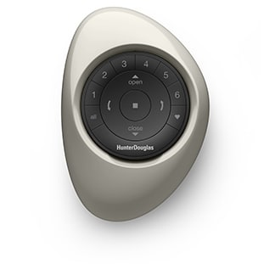
Remote control
The inherent cordless design of our PowerView® Automation system provides you and your family with the ultimate in operating convenience and enhanced safety at the window.

Slide 7
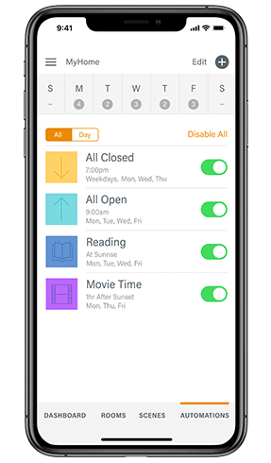
Take charge of your shades
For Smart Living
PowerView Motorization lets you schedule your Designer Screen Shades to open and close on their own—at any time of the day—with the touch of a button, a tap on a mobile device or the sound of your voice. So forgo the alarm clock, and use light as a wake-up call instead.*

Slide 8
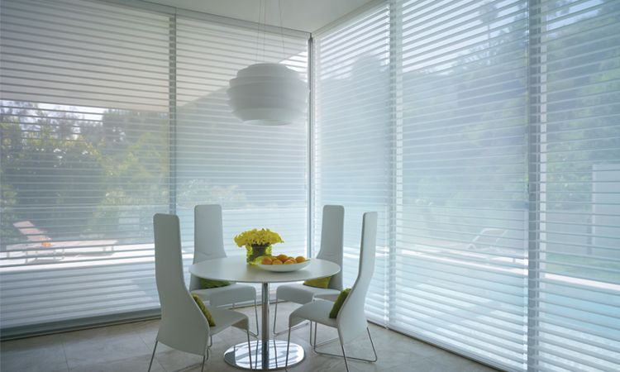
Silhouette shades
From blocking out the sun to enhancing the natural light in your home. The translucent fabrics that many of our products offer are specially engineered to diffuse harsh sunlight and draw it deeper into the room—dispersing the light to help illuminate your home naturally and reduce the need for artificial light.

Slide 9
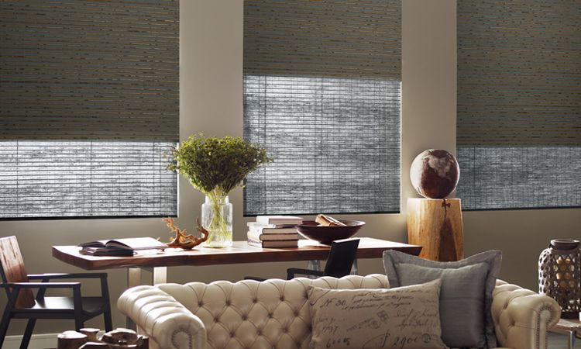
woven wood shades
If you are looking for optional room darkening capabilities, consider a room darkening liner available on many of our shades. The liner can be sewn directly to the face fabric, or for ultimate flexibility, can operate independently.

Slide 10
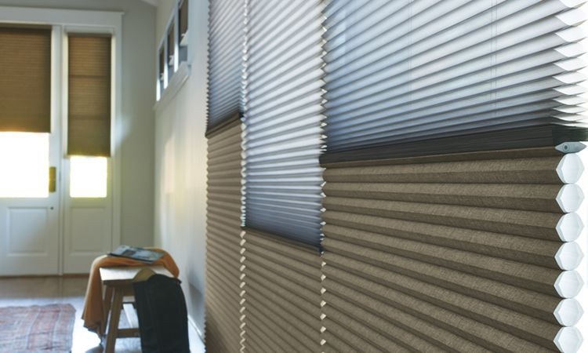
Honeycomb shades-sheer & solid
Our Duolite feature offers maximum light control by using two separate fabric panels to achieve a 'day/night' level of convenience, providing limitless options for privacy and light control.

Slide 11
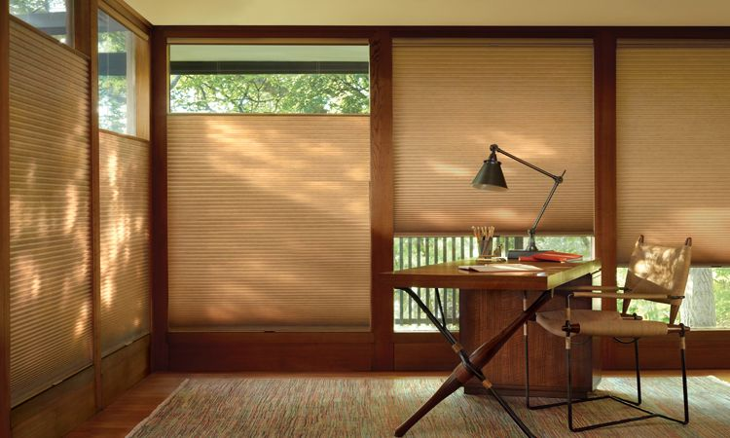
Honeycomb shades-Top down-bottom up
With innovations like our unique Top-Down/Bottom-Up operating system, you can maintain your privacy and still enjoy the natural light.

Slide 12
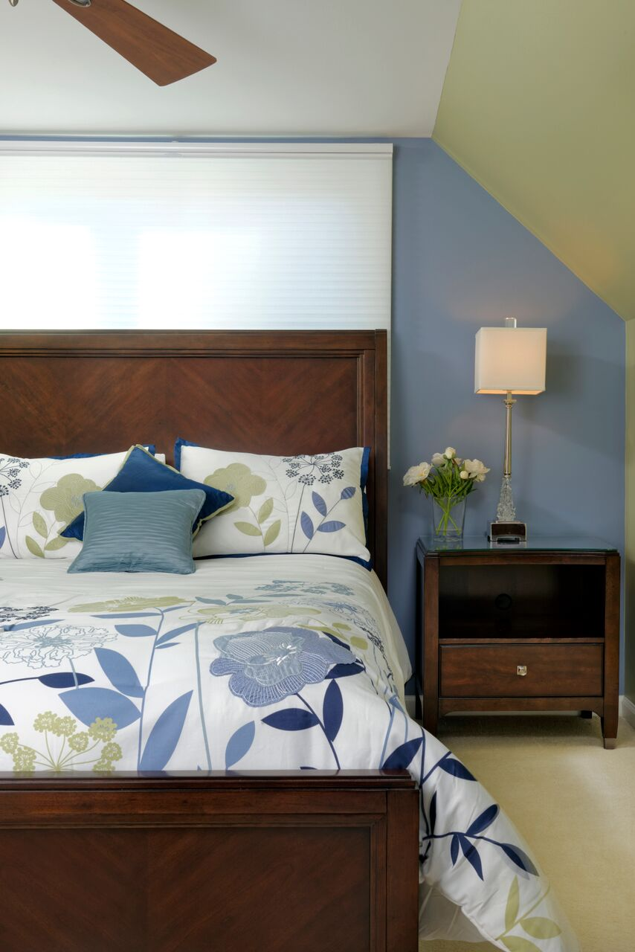
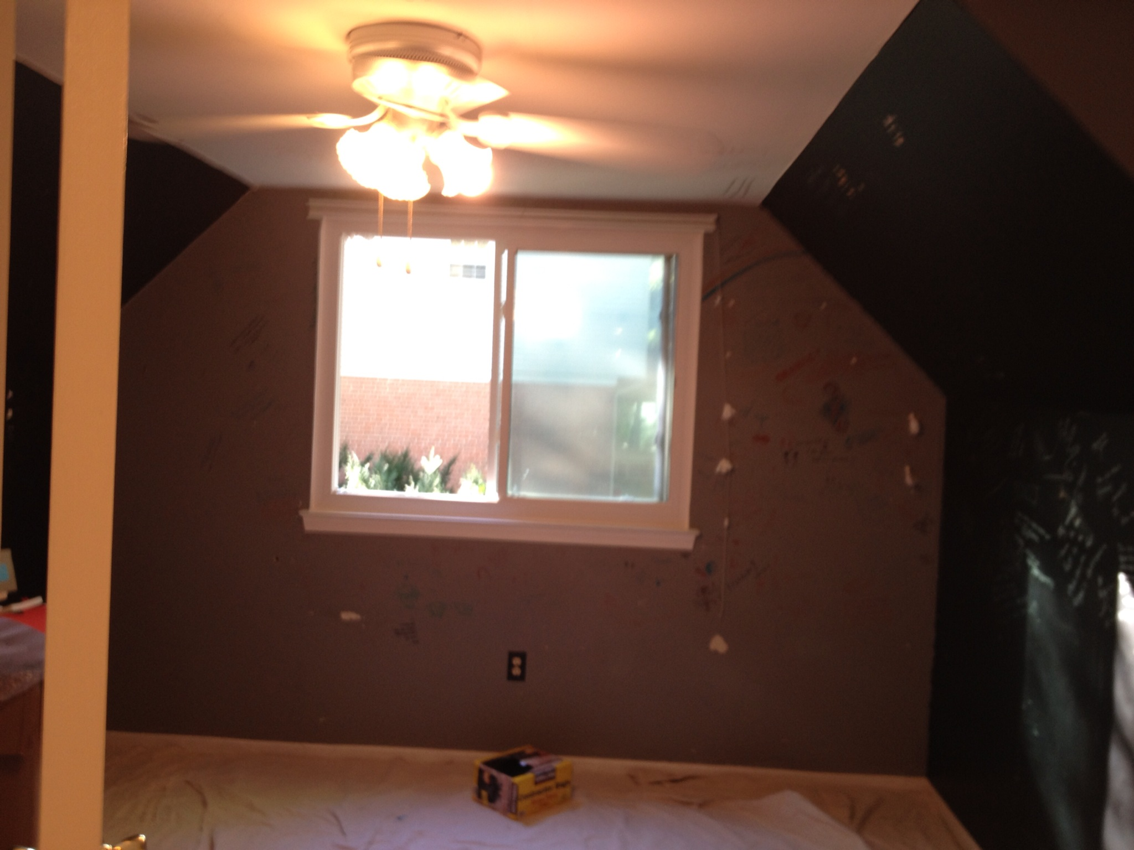
TDBU Honeycomb shade in a bedroom-before & after

Slide 13
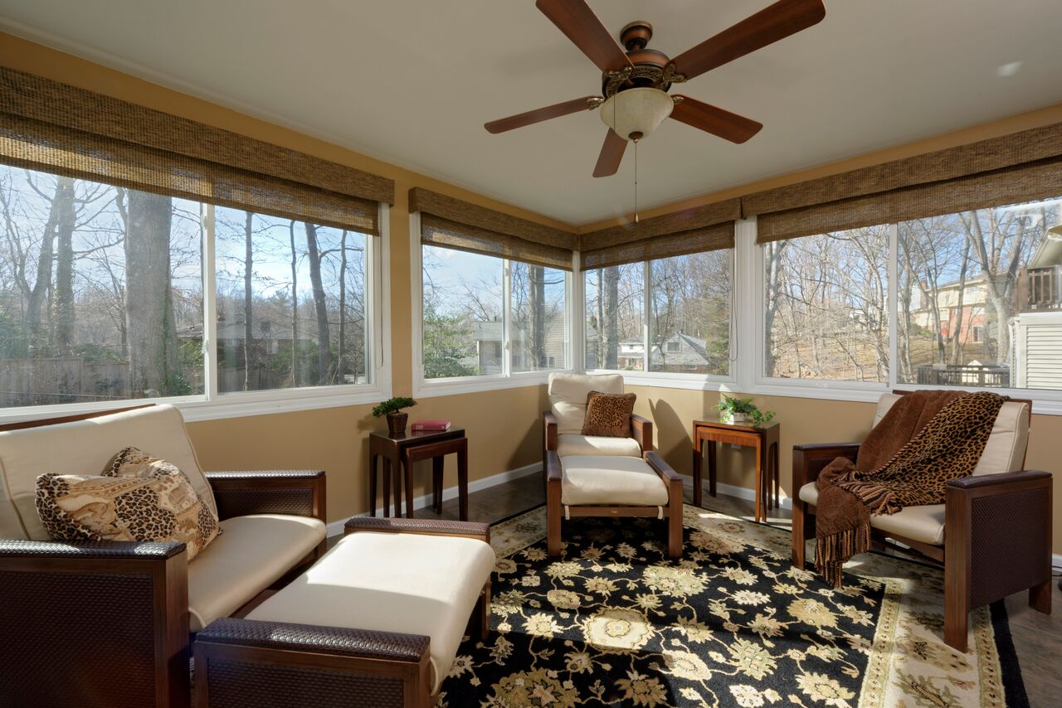
Indoor woven woods roller shades in porch

Slide 14
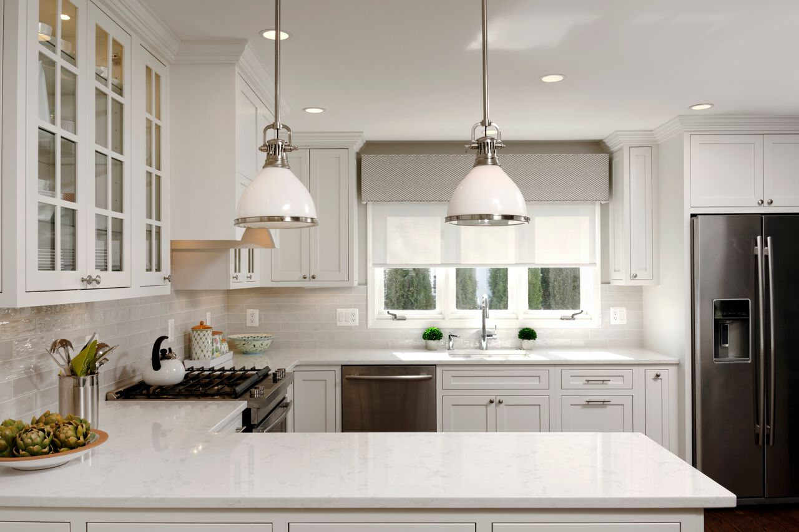
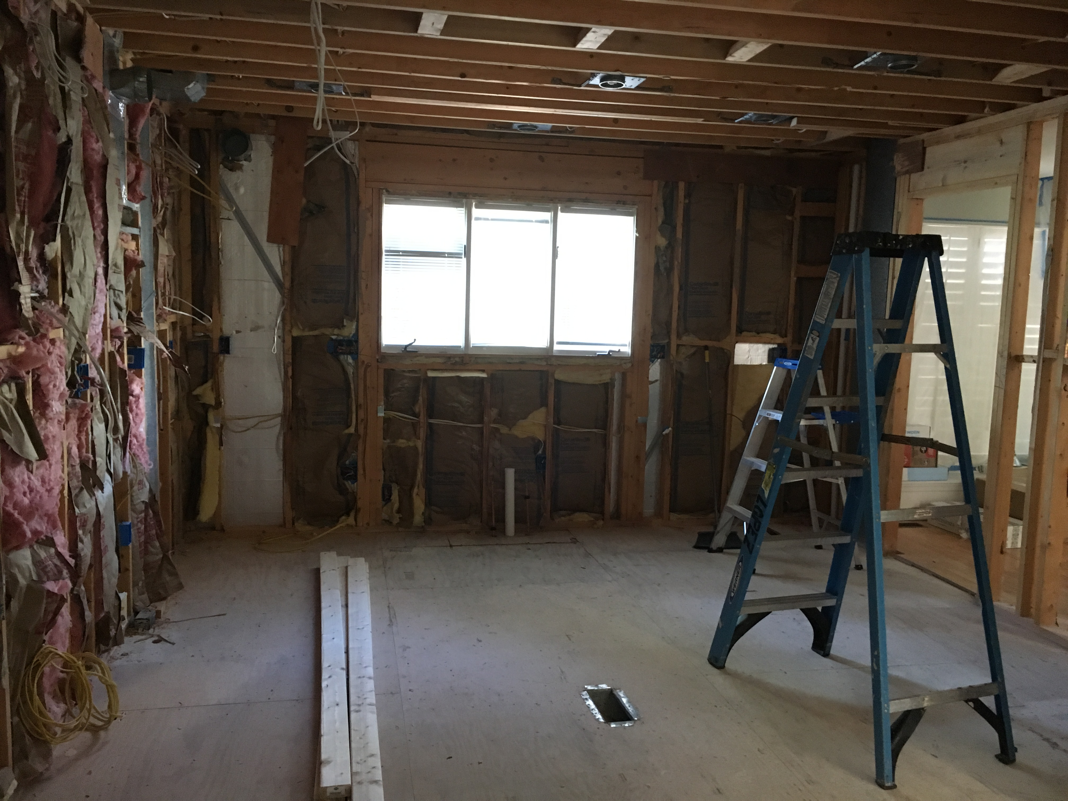
Screen Shade with Cornice in kitchen

Slide 15
FTC Interiors-
taking the guesswork out of design
www.FTCInteriors.com
andrea@FTCInteriors.com
703-407-3770

